Slide 1
Engineering Materials (BME 15)
Material science : it deals with the study of structure, properties and application of the materials so that the properties of existing materials can be developed, and new materials can be developed to full fill our engineering needs.
solid materials have been conveniently grouped into three basic categories, ( based on chemical make up and atomic structure)
MATALS
CERAMICS
POLYMERS
In addition there are composites , which are engineered combination of two or more different materials
Apart from this classification we have different types of materials in present scenario, which are advance materials . (semiconductors, bio materials, smart materials and nanoengineered materials)

Slide 2
Engineering materials
Metals
polymers
ceramics
Oxides, nitrides, carbides, glass ceramics, graphite , diamond
Ferrous
thermoplastics
Steels, cast iron, stainless steel etc.
Nylons, PVC, polyethylene etc.
Non ferrous
thermosets
Epoxies, phenolics, polymides etc.
Al, Cu, W, Ag etc.
Amorphous
elastomers
Gels, glasses etc.
Rubber, silicones etc.

Slide 3

Atomic model
During the latter part of the nineteenth century it was realized that many phenomena involving electrons in solids could not be explained in terms of classical mechanics.
What followed was the establishment of a set of principles and laws that govern systems of atomic and subatomic entities that came to be known as quantum mechanics.
An atomic model represents what the structure of an atom could look like , based on which we can predict its behavior.
It is not necessarily a true picture of the exact structure of an atom.

Slide 4

Various scientists discovered the different atomic models in progression of time and keep on moving towards more accurate atomic model but none of which is the perfect atomic model to demonstrate the true picture inside the atom .
So let’s study some important atomic models which are helpful to understand the concept of the structure of an atom.

Slide 5
1.Dalton’s model of the atom (1766-1844)
Matters are made of very tiny particles called atoms which are indivisible structure.
Atoms can neither be created nor destroyed.
All atoms of particular elements are similar in all respects including identical mass , physical and chemical properties.
Atoms of different elements shows different properties.
Compound are formed when atoms of different elements combine in a fixed ratio.
In this model electron and nucleus were unknown.

Slide 6

2.Thomson’s atomic model (1897)
Atoms were made up of smaller particles.
Atoms are made up of negative electrons that float in a soup of positive charge.
Also known as plum pudding model.
-
-
Positive charge soup
-
-
electron
-
-

Slide 7
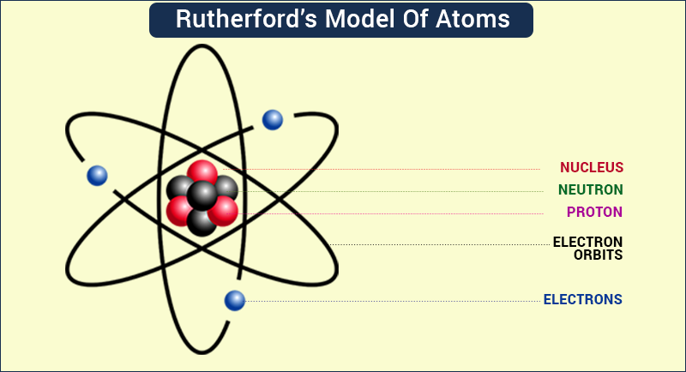
3.Rutherford’s atomic model (1911)
On the basis of alpha particles scattering experiment, Rutherford described the atom as a dense tiny positively charged core called nucleus, in which nearly all mass is concentrated, around which the lightly weighted negative elements called electron propagate at some distance similar to planets revolving around the sun.
Also known as planetary model of the atom.
Reference: https://byjus.com/chemistry/rutherfords-model-of-atoms-and-its-limitations/

Slide 8
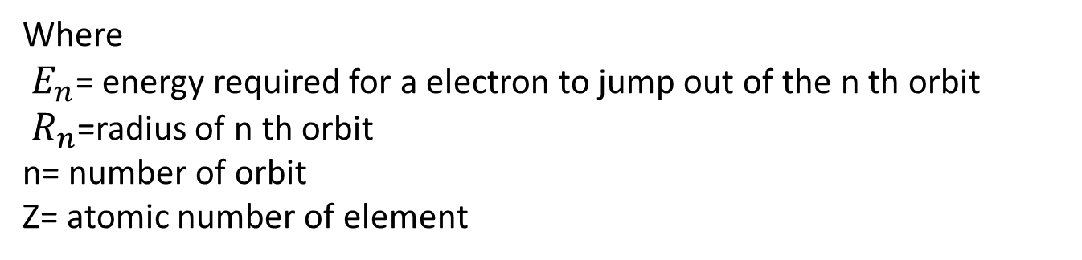
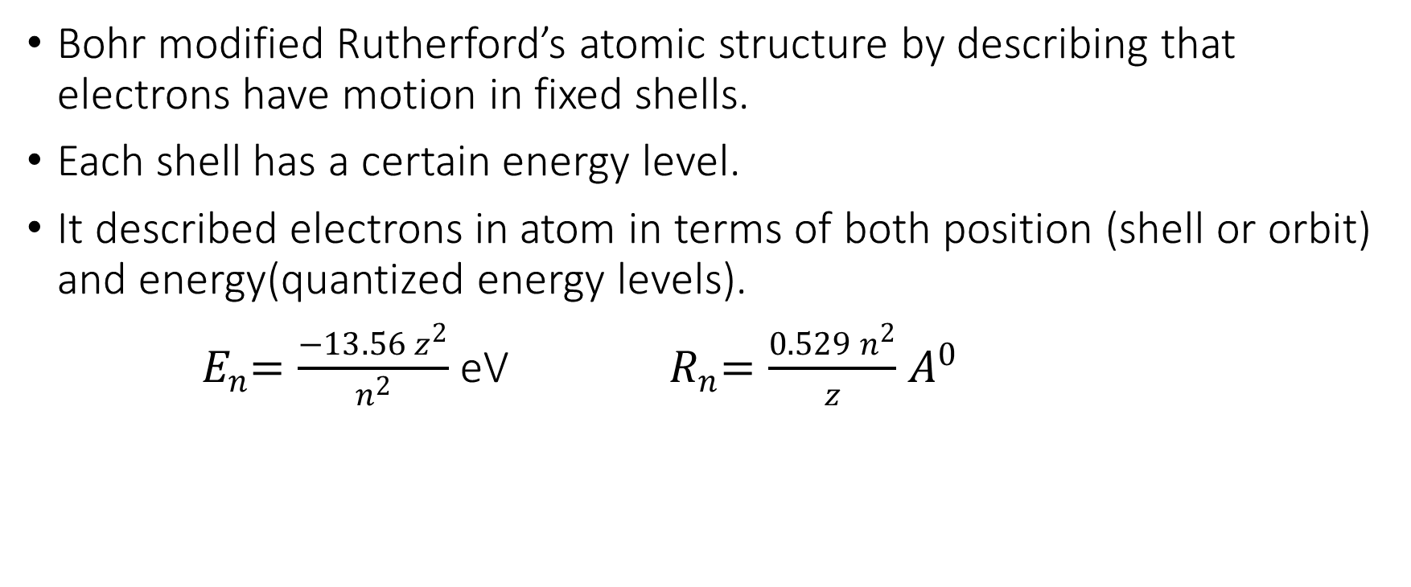
4.Bohr’s model of the atom (1913)
Bohr modified Rutherford’s atomic structure by describing that electrons have motion in fixed shells.
Each shell has a certain energy level.
It described electrons in atom in terms of both position (shell or orbit) and energy(quantized energy levels).
${ E}_{n}=\frac{−13.56 z^{2}}{n^{2}}$ eV ${ R}_{n}=\frac{0.529 n^{2}}{z}$ $A^{0}$
Where
${ E}_{n}$= energy required for a electron to jump out of the n th orbit
${ R}_{n}$=radius of n th orbit
n= number of orbit
Z= atomic number of element

Slide 9
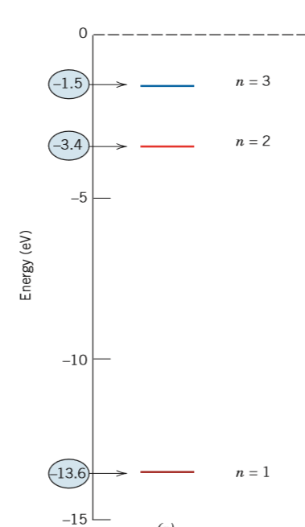
Bohr’s model of the atom (1913) continues….
Orbit or shell
n = shell or orbit number
Nucleus
Orbital electron
The first 3 electron energy states for the Bohr hydrogen atom.

Slide 10
5.Wave mechanical model / electron model (1927) by Erwin Schrodinger
He combined the bohr’s model with De Broglie’s hypothesis.
He proposed the electron was a 3D waveform circling the nucleus in a whole number of wavelengths allowing the waveform to repeat itself as a stable standing wave representing the energy levels of the bohr’s model.
Position of electron is considered to be probability of an electron being at various locations around the nucleus.
Position is described by a probability distribution or electron cloud.

Slide 11
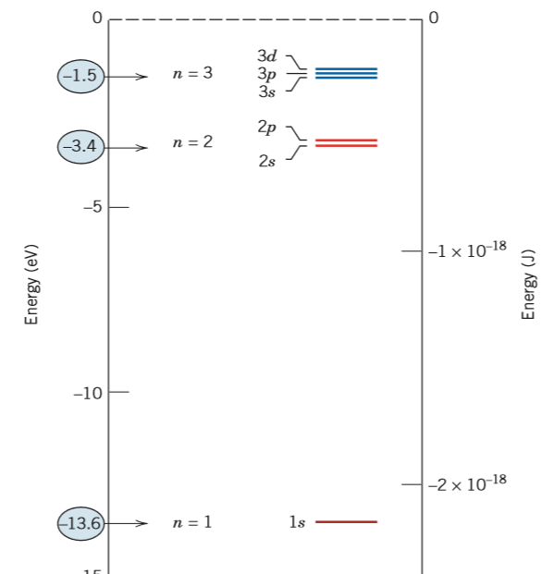
Electron model (1927) continues…
Using wave mechanics every electron in the atom is characterized by 4 parameters called quantum number.

Slide 12
Crystal structures
A crystalline material is one in which the atoms are situated in a repeating or periodic array over large atomic distances; that is, long-range order exists, such that upon solidification, the atoms will position themselves in a repetitive three-dimensional pattern, in which each atom is bonded to its nearest-neighbor atoms.
Sometimes the term lattice is used in the context of crystal structures; in this sense lattice means a three-dimensional array of points coinciding with atom positions (or sphere centers). The point of center of atom in space lattice is known as lattice point.
The properties of some materials are directly related to their crystal structures.
significant property differences exist between crystalline and non crystalline materials having the same composition.
All metals, many ceramic materials, and certain polymers form crystalline structures under normal solidification conditions.

Slide 13
Unit cell
The atomic order in crystalline solids indicates that small groups of atoms form a repetitive pattern. Thus, in describing crystal structures, it is often convenient to subdivide the structure into small repeat entities called unit cells.
Unit cells for most crystal structures are parallelepipeds or prisms having three sets of parallel faces.
the unit cell is the basic structural unit or building block of the crystal structure and defines the crystal structure by virtue of its geometry and the atom positions within.

Slide 14
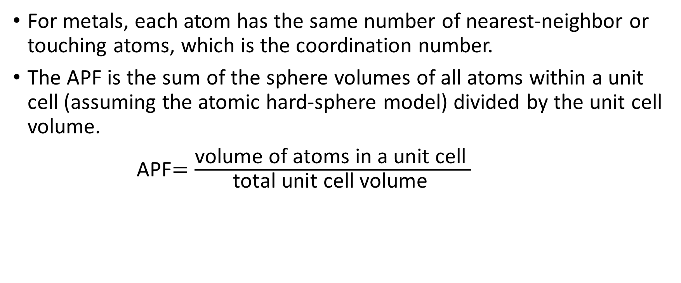
Coordination number and the atomic packing factor (APF).
For metals, each atom has the same number of nearest-neighbor or touching atoms, which is the coordination number.
The APF is the sum of the sphere volumes of all atoms within a unit cell (assuming the atomic hard-sphere model) divided by the unit cell volume.
APF$=\frac{\text{volume} \text{of} \text{atoms} \text{in} \text{a} \text{unit} \text{cell} }{\text{total} \text{unit} \text{cell} \text{volume} }$

Slide 15
Bravais lattice
There are only 14 independent ways of arranging points in a three dimension space on pure symmetry consideration.
If all the atoms at the lattice points are identical , the space lattice is said to be a bravais lattice.
These 14 bravais lattices belong to 7 crystal systems.

Slide 16
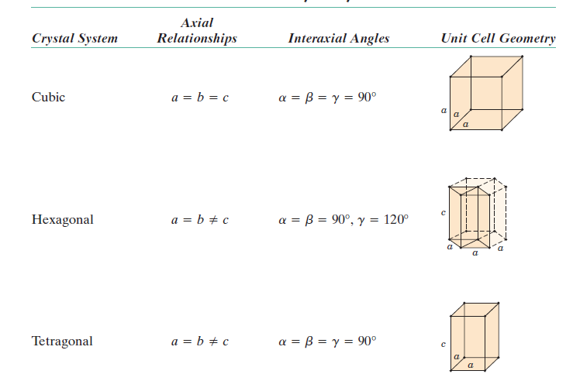

Slide 17
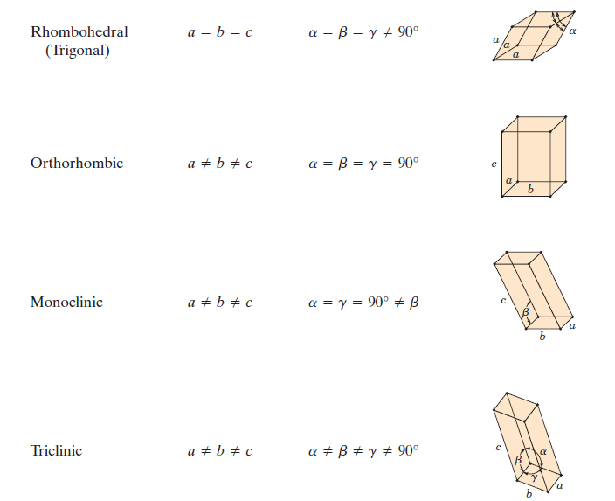

Slide 18
CRYSTAL SYSTEM | Space lattice
CUBIC | Simple Body centered Face centered
TETRAGONAL | Simple Body centered
ORTHORHOMBIC | Simple End centered/base centered/side centered Body centered Face centered
RHOMBOHEDRAL | simple
HEXAGONAL | simple
MONOCLINIC | Simple End centered
TRICLINIC (least symmetric among all 14) | simple

Slide 19
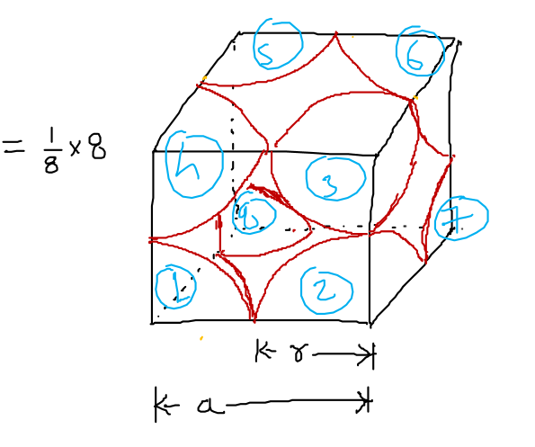
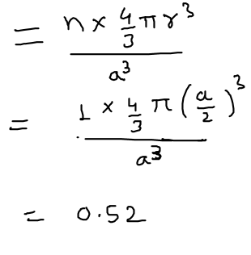
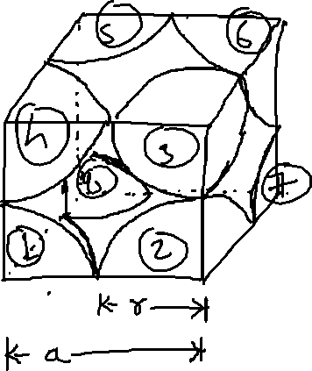
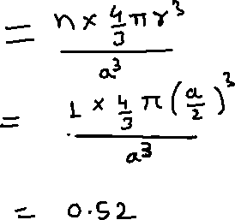
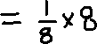
Simple cubic structure
Atoms located at all eight corners.
Number of atom in a unit cell is 1
Mn has SC structure.
Coordination number = 6.
APF

Slide 20
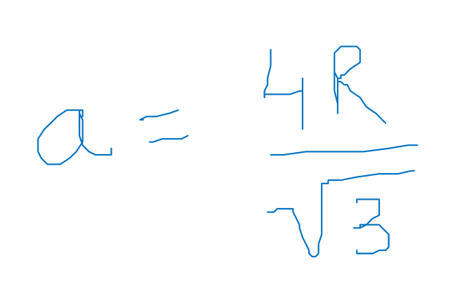
Body centered cubic structure
Atoms located at all eight corners and a single atom at the cube center.
unit cell length a and atomic radius R are related through
Chromium, iron, tungsten exhibit a BCC structure.
Two atoms are associated with each BCC unit cell: the equivalent of one atom from the eight corners, each of which is shared among eight unit cells, and the single center atom, which is wholly contained within its cell.
The coordination number for the BCC crystal structure is 8.
Atomic packing factor for BCC is 0.68.

Slide 21
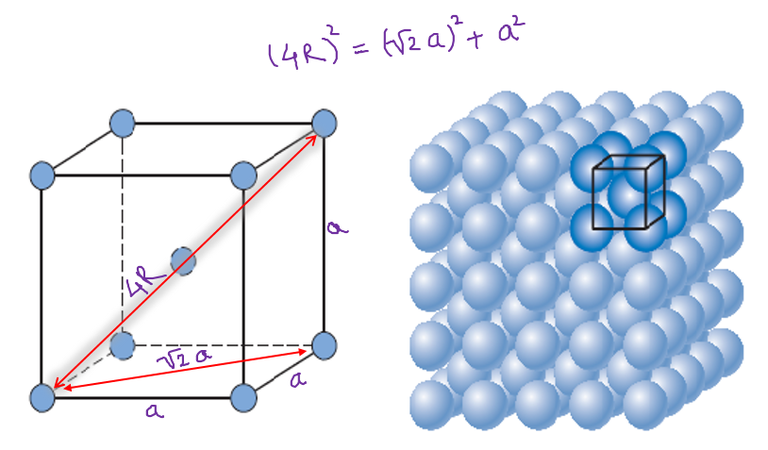
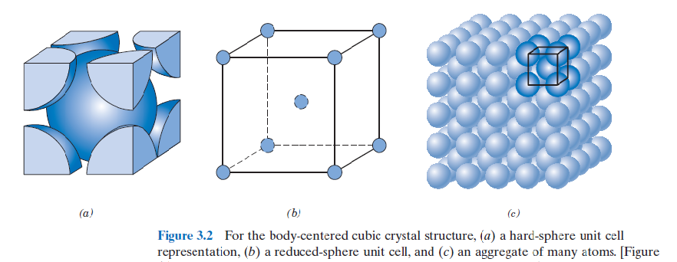
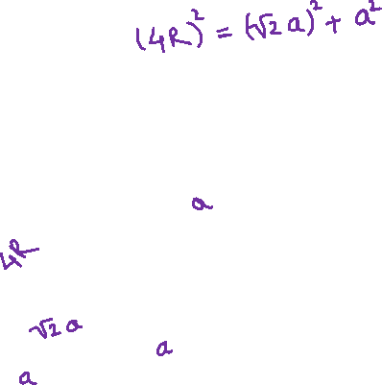

Slide 22
Face centered cubic structure (FCC)
The crystal structure found for many metals has a unit cell of cubic geometry, with atoms located at each of the corners and the centers of all the cube faces.
Some of the familiar metals having this crystal structure are copper, aluminum, silver, and gold.
Coordination number = 12
Number of atoms within unit cell = 4

Slide 23
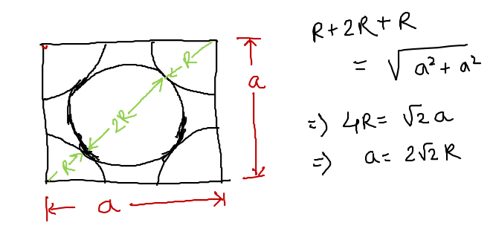
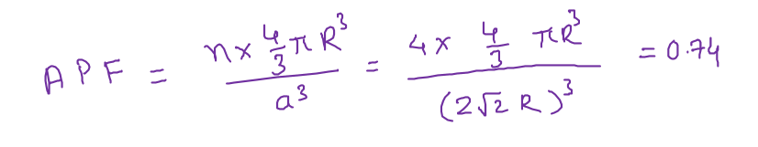

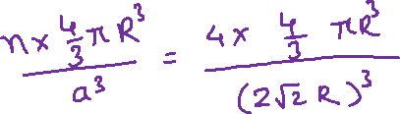
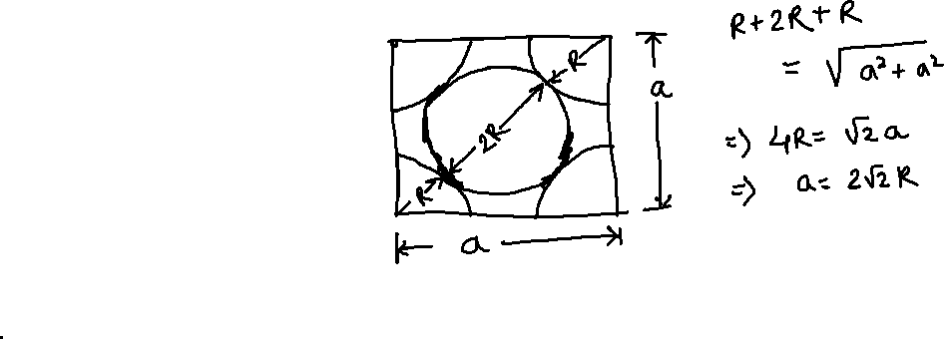
These spheres or ion cores touch one another across a face diagonal; the cube edge length a and the atomic radius R are related through
Atomic packing factor for FCC is 0.74.

Slide 24
Hexagonal Close-Packed Crystal Structure (HCP)
The top and bottom faces of the unit cell consist of six atoms that form regular hexagons and surround a single atom in the center. Another plane that provides three additional atoms to the unit cell is situated between the top and bottom planes.
The coordination number and the atomic packing factor for the HCP crystal structure are the same as for FCC: 12 and 0.74, respectively.
Total number of atoms within the unit cell is 6.

Slide 25
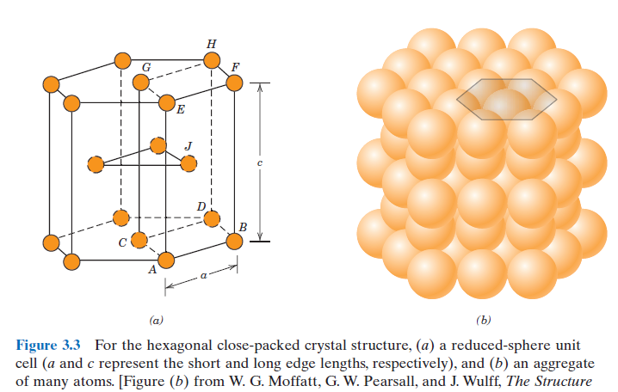

Slide 26

Consider atom ‘a’ that touches 6 atoms in the plane shown. We can see the arrangement of atoms in this plane. similar planes are also present over and below the plane shown. So think how can atoms arrange themselves to accommodate properly.
1
2
3
4
5
6
7
a
b
c
8
9
10
In similar way another three atoms touches atom ‘a’
So total 12 atoms touches atom ‘a’ . It is true for any atom in the structure. That is coordinator number

Slide 27
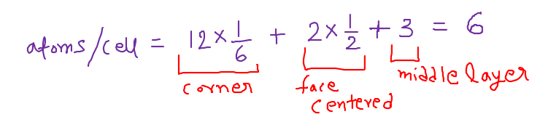
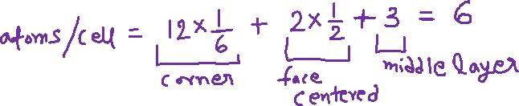
Hexagonal consists of 3 layers of atoms (see 1st fig) and suppose the layer shown here is the top layer of hexagonal.(in middle layer, 3 atoms present that are within the hexagonal and not shared with other. )
Consider 3 hexagonal which has centered atom named 4, b and 8.
‘a’ is common in these 3 hexagonal and above this layer there is another layer (hexagonal) ,where ‘a’ is shared by 3 hexagonal.
So the corner atom is shared by 6 hexagonal.
Center atom (b) is shared by 2 hexagonal . That is above the plane shown.
1
2
3
4
5
6
7
a
b
c
8
9
10

Slide 28
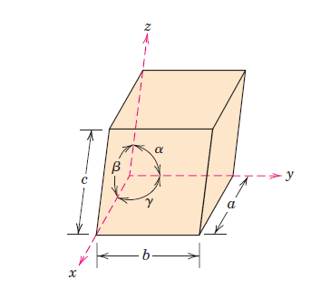
Crystallographic Points, Directions, and Planes
When dealing with crystalline materials, it often becomes necessary to specify a particular point within a unit cell, a crystallographic direction, or some crystallographic plane of atoms.
Labeling conventions have been established in which three numbers or indices are used to designate point locations, directions, and planes.
The basis for determining index values is the unit cell, with a right-handed coordinate system consisting of three (x, y, and z) axes situated at one of the corners and coinciding with the unit cell edges, as shown in Figure .
For some crystal systems—namely, hexagonal, rhombohedral, monoclinic, and triclinic—the three axes are not mutually perpendicular, as in the familiar Cartesian coordinate scheme.
A unit cell with x, y, and z coordinate axes, showing axial lengths (a, b, and c) and interaxial angles(α, β , and γ ).

Slide 29
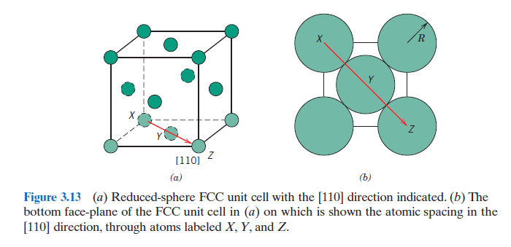
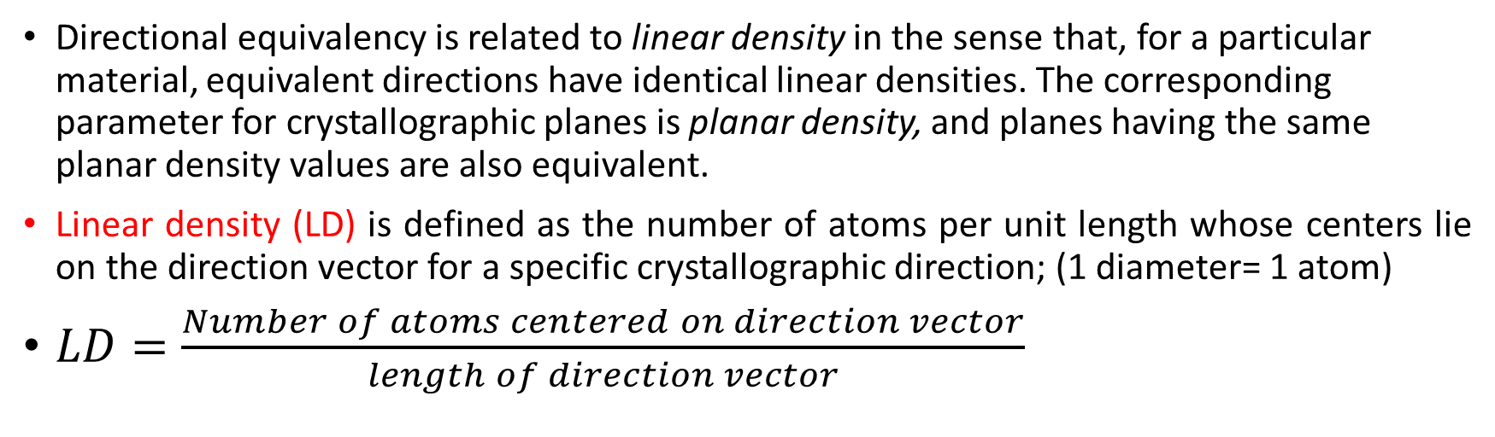
LINEAR AND PLANAR DENSITIES
Directional equivalency is related to linear density in the sense that, for a particular material, equivalent directions have identical linear densities. The corresponding parameter for crystallographic planes is planar density, and planes having the same planar density values are also equivalent.
Linear density (LD) is defined as the number of atoms per unit length whose centers lie on the direction vector for a specific crystallographic direction; (1 diameter= 1 atom)
$LD=\frac{Number of atoms centered on direction vector}{length of direction vector}$

Slide 30
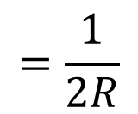
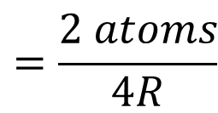
For example, let us determine the linear density of the [110] direction for the FCC crystal structure. An FCC unit cell (reduced sphere) and the [110] direction therein are shown in Figure 3.13a. Represented in Figure 3.13b are the five atoms that lie on the bottom face of this unit cell; here the [110] direction vector passes from the center of atom X, through atom Y, and finally to the center of atom Z. With regard to the numbers of atoms, it is necessary to take into account the sharing of atoms with adjacent unit cells (as discussed in Section 3.4 relative to atomic packing factor computations). Each of the X and Z corner atoms is also shared with one other adjacent unit cell along this [110] direction (i.e., one-half of each of these atoms belongs to the unit cell being considered), while atom Y lies entirely within the unit cell. Thus, there is an equivalence of two atoms along the [110] direction vector in the unit cell. Now, the direction vector length is equal to 4R (Figure 3.13b); thus, from Equation 3.8, the [110] linear density for FCC is
$$=\frac{2 atoms}{4R}$$
$$=\frac{1}{2R}$$
LD110

Slide 31
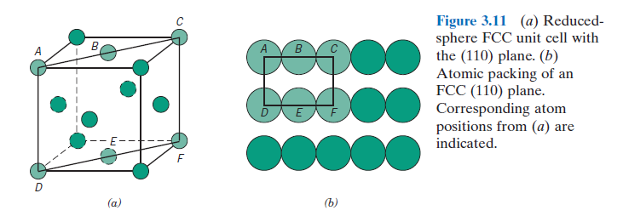
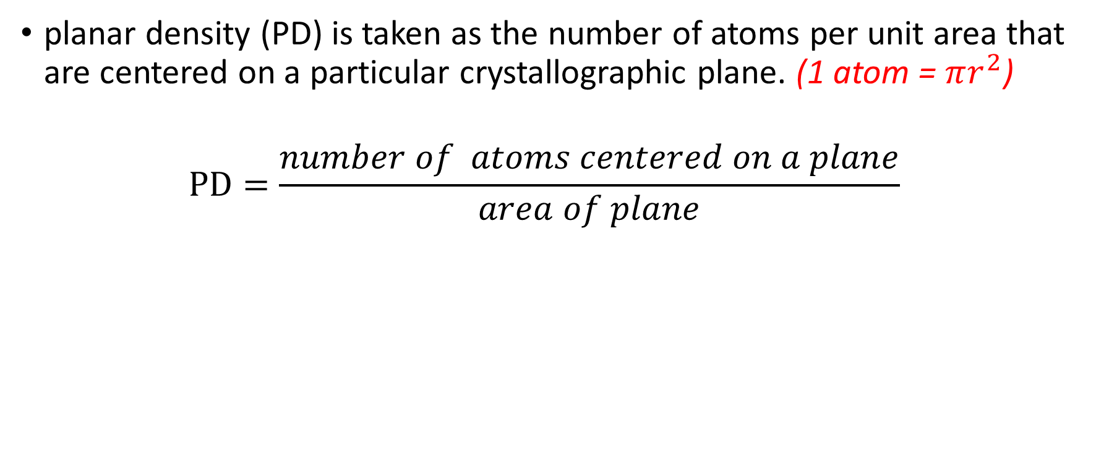
Planar Density (PD)
planar density (PD) is taken as the number of atoms per unit area that are centered on a particular crystallographic plane. (1 atom = $πr^{2}$)
$$PD=\frac{number of atoms centered on a plane}{area of plane}$$

Slide 32
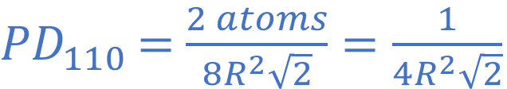
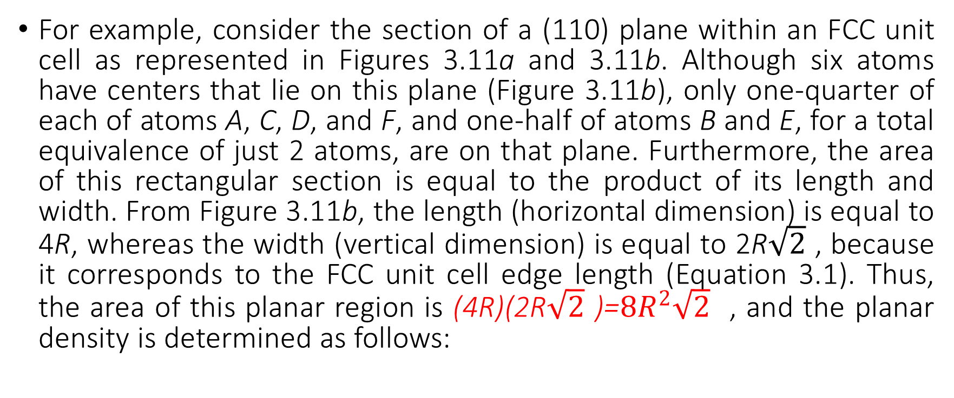
For example, consider the section of a (110) plane within an FCC unit cell as represented in Figures 3.11a and 3.11b. Although six atoms have centers that lie on this plane (Figure 3.11b), only one-quarter of each of atoms A, C, D, and F, and one-half of atoms B and E, for a total equivalence of just 2 atoms, are on that plane. Furthermore, the area of this rectangular section is equal to the product of its length and width. From Figure 3.11b, the length (horizontal dimension) is equal to 4R, whereas the width (vertical dimension) is equal to 2R$\sqrt{2}$ , because it corresponds to the FCC unit cell edge length (Equation 3.1). Thus, the area of this planar region is (4R)(2R$\sqrt{2}$ )=$8R^{2}\sqrt{2}$ , and the planar density is determined as follows:
${PD}_{110}$ $=$ $\frac{2 atoms}{8R^{2}\sqrt{2}}=\frac{1}{4R^{2}\sqrt{2}}$

Slide 33
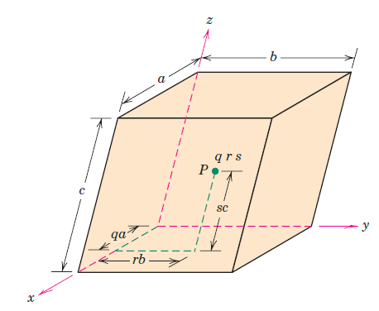
POINT COORDINATES
The position of any point located within a unit cell may be specified in terms of its coordinates as fractional multiples of the unit cell edge lengths (i.e., in terms of a, b, and c).
To illustrate, consider the unit cell and the point P situated therein as shown in Figure
We specify the position of P in terms of the generalized coordinates q, r, and s where q is some fractional length of a along the x axis, r is some fractional length of b along the y axis, and similarly for s. Thus, the position of P is designated using coordinates q r s with values that are less than or equal to unity.
Furthermore, we have chosen not to separate these coordinates by commas or any other punctuation marks (which is the normal convention).

Slide 34
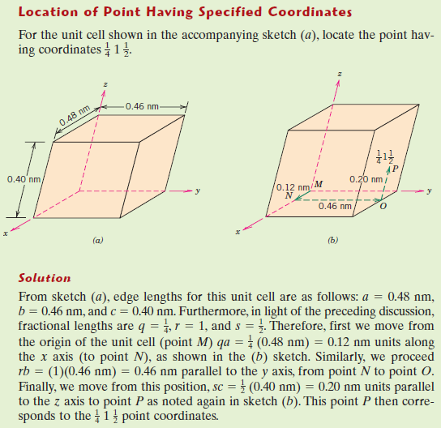
Example 1

Slide 35
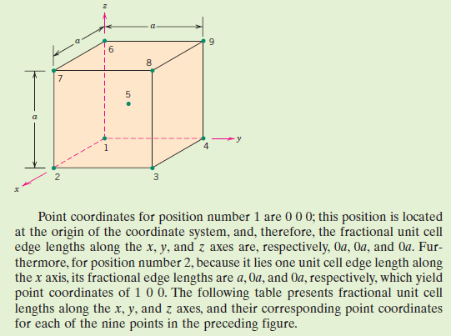
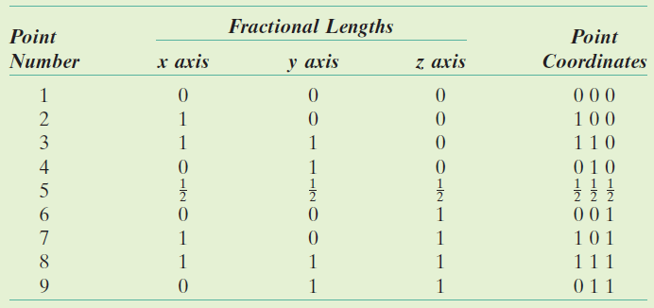
Example 2 Specify point coordinates for all atom positions for a BCC unit cell.

Slide 36
CRYSTALLOGRAPHIC DIRECTIONS
A crystallographic direction is defined as a line between two points, or a vector. The following steps are used to determine the three directional indices:
A vector of convenient length is positioned such that it passes through the origin of the coordinate system. Any vector may be translated throughout the crystal lattice without alteration, if parallelism is maintained.
The length of the vector projection on each of the three axes is determined; these are measured in terms of the unit cell dimensions a, b, and c.
These three numbers are multiplied or divided by a common factor to reduce them to the smallest integer values.
The three indices, not separated by commas, are enclosed in square brackets, thus: [uvw]. The u, v, and w integers correspond to the reduced projections along the x, y, and z axes, respectively.
For each of the three axes, there will exist both positive and negative coordinates. Thus negative indices are also possible, which are represented by a bar over the appropriate index.

Slide 37
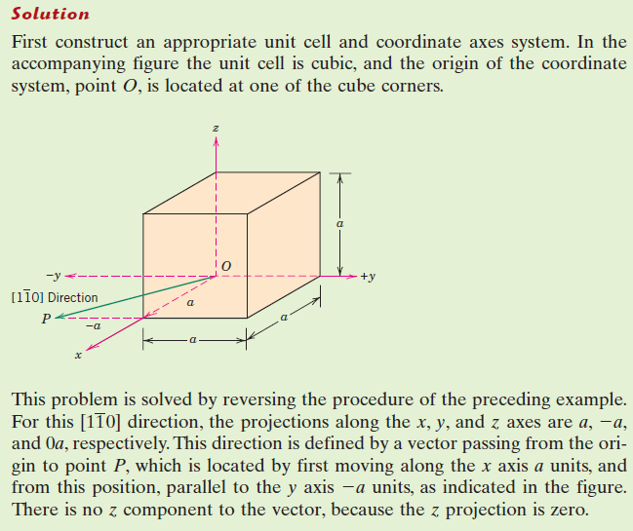
Example 3 Draw a [110] direction within a cubic unit cell.

Slide 38
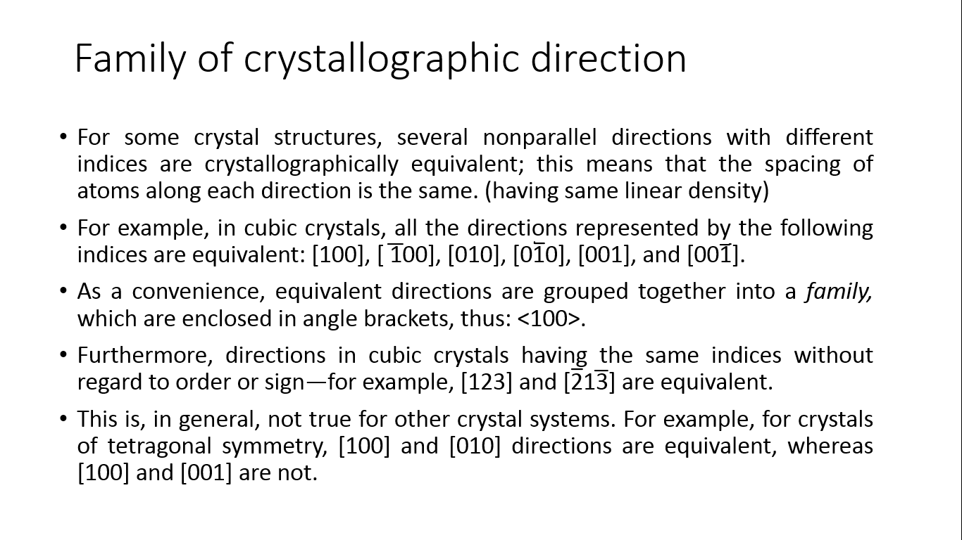
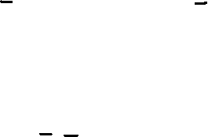
Family of crystallographic direction
For some crystal structures, several nonparallel directions with different indices are crystallographically equivalent; this means that the spacing of atoms along each direction is the same. (having same linear density)
For example, in cubic crystals, all the directions represented by the following indices are equivalent: [100], [ 100], [010], [010], [001], and [001].
As a convenience, equivalent directions are grouped together into a family, which are enclosed in angle brackets, thus: <100>.
Furthermore, directions in cubic crystals having the same indices without regard to order or sign—for example, [123] and [213] are equivalent.
This is, in general, not true for other crystal systems. For example, for crystals of tetragonal symmetry, [100] and [010] directions are equivalent, whereas [100] and [001] are not.

Slide 39
CRYSTALLOGRAPHIC PLANES
crystallographic planes are specified by three Miller indices as (hkl). Any two planes parallel to each other are equivalent and have identical indices. The procedure used to determine the h, k, and l index numbers is as follows:
If the plane passes through the selected origin, either another parallel plane must be constructed within the unit cell by an appropriate translation, or a new origin must be established at the corner of another unit cell.
At this point the crystallographic plane either intersects or parallels each of the three axes; the length of the planar intercept for each axis is determined in terms of the lattice parameters a, b, and c.
The reciprocals of these numbers are taken. A plane that parallels an axis may be considered to have an infinite intercept, and, therefore, a zero index.
If necessary, these three numbers are changed to the set of smallest integers by multiplication or division by a common factor.
Finally, the integer indices, not separated by commas, are enclosed within parentheses, thus: (hkl).
An intercept on the negative side of the origin is indicated by a bar or minus sign positioned over the appropriate index. Furthermore, reversing the directions of all indices specifies another plane parallel to, on the opposite side of, and equidistant from the origin.

Slide 40
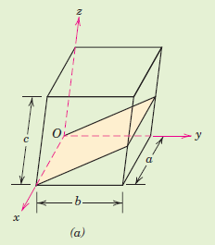
Example 3
Determine the Miller indices for the plane shown in the accompanying sketch (a).

Slide 41
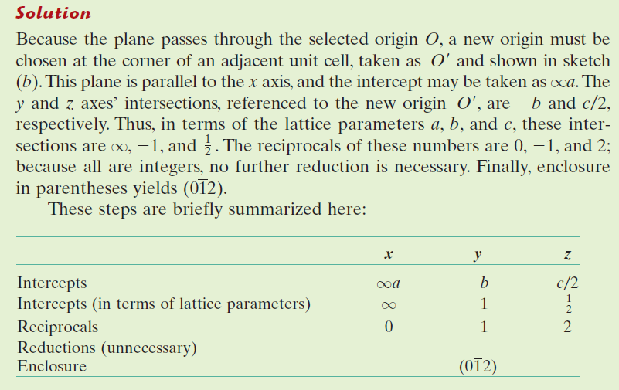
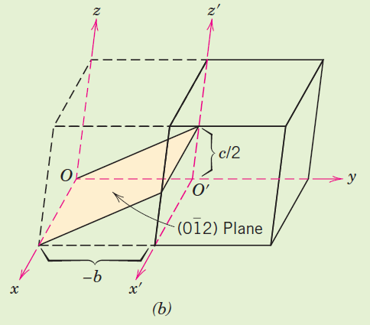

Slide 42
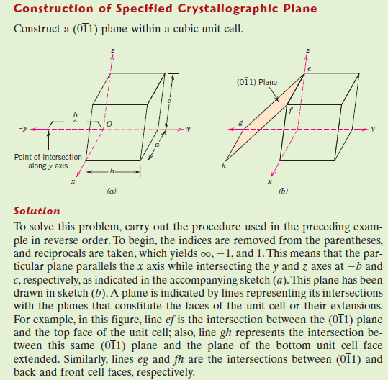
Example 4

Slide 43
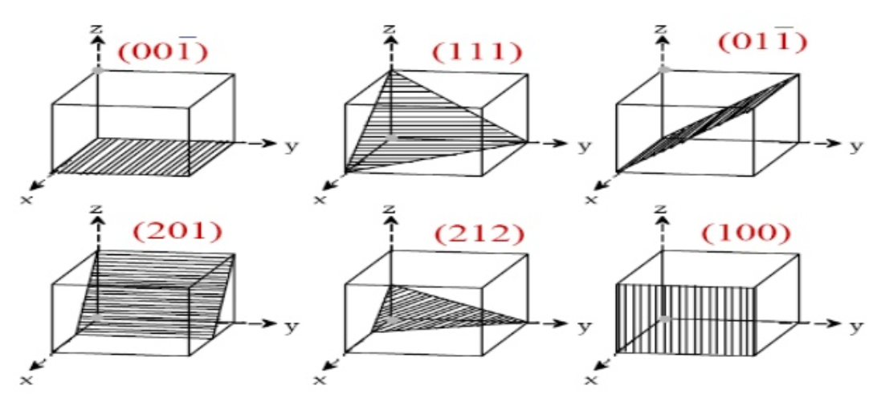
Some planes are shown in a cubic unit cell
Reference: http://www.examhill.com/miller-indices/

Slide 44
Imperfection in solid
Any crystal with perfectly regular crystal structure is called ideal crystal while real crystals always have certain defects or imperfections.
Many of the properties of materials are profoundly sensitive to deviations from crystalline perfection; the influence is not always adverse, and often specific characteristics are deliberately fashioned by the introduction of controlled amounts or numbers of particular defects.
Crystalline defect refers to a lattice irregularity having one or more of its dimensions on the order of an atomic diameter.

Slide 45
S No. | Imperfection type | Size of defect | Sub type
1 | Point defects | Zero dimensional defect (interatomic space) | Vacancy Substitutional impurity Interstitial impurity Frenkel’s defect Schottky’s defect
2 | Line defect | One dimensional defect | Edge dislocation Screw dislocation Mixed dislocation
3 | Surface imperfection (interfacial defect) | Two dimensional defect | External surface Grain boundary Twinning Low angle boundary High angle boundary Twist boundary Stacking fault
4 | Volume defect | Three dimensional defect | pores Foreign particle inclusion Non compatibility region Dissimilar natured regions

Slide 46
Vacancy defect
In crystallography , a vacancy is a point defect in a crystal where a atom is missing from one of the lattice site.
Vacancy defects are lattice sites which would be occupied in a perfect crystal, but are vacant. If a neighboring atom moves to occupy the vacant site, the vacancy moves in the opposite direction to the site which used to be occupied by the moving atom.
The stability of the surrounding crystal structure guarantees that the neighboring atoms will not simply collapse around the vacancy. In some materials, neighboring atoms actually move away from a vacancy, because they experience attraction from atoms in the surroundings. A vacancy (or pair of vacancies in an ionic solid) is sometimes called a Schottky defect.

Slide 47
Interstitial defect
Interstitial defect are atoms that occupy a site in the crystal structure at which there is usually not an atom.
They are generally high energy configurations. Small atoms (mostly impurities) in some crystals can occupy interstices without high energy, such as hydrogen in palladium.
The interstitial atom has more chances to be lodge with in a crystal structure has low atomic packing factor.
It produces atomic distortion.
A nearby pair of a vacancy and an interstitial is often called a Frenkel defect or Frenkel pair. This is caused when an ion moves into an interstitial site and creates a vacancy.

Slide 48
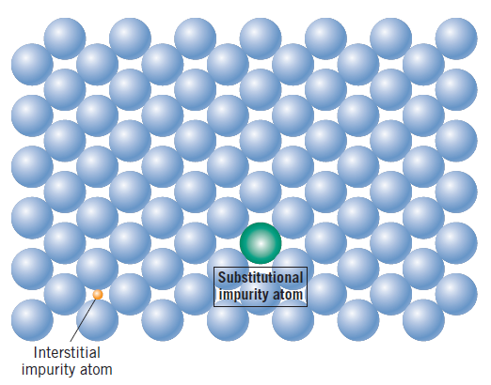
Substitutional defects
When a foreign atom replaces the parent atom at the lattice site in the crystal
Foreign atom is called solute and parent atoms are solvent.

Slide 49
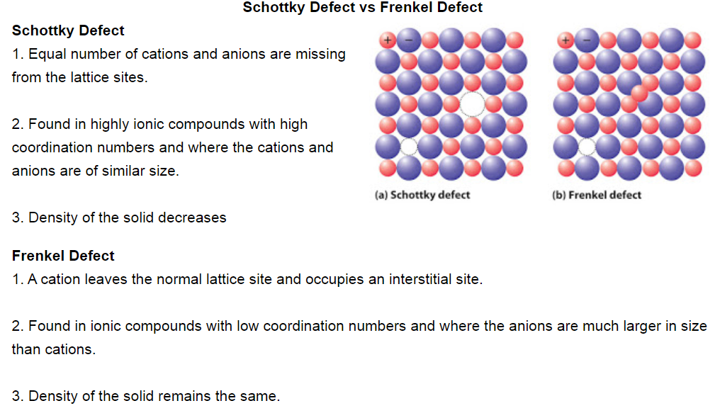
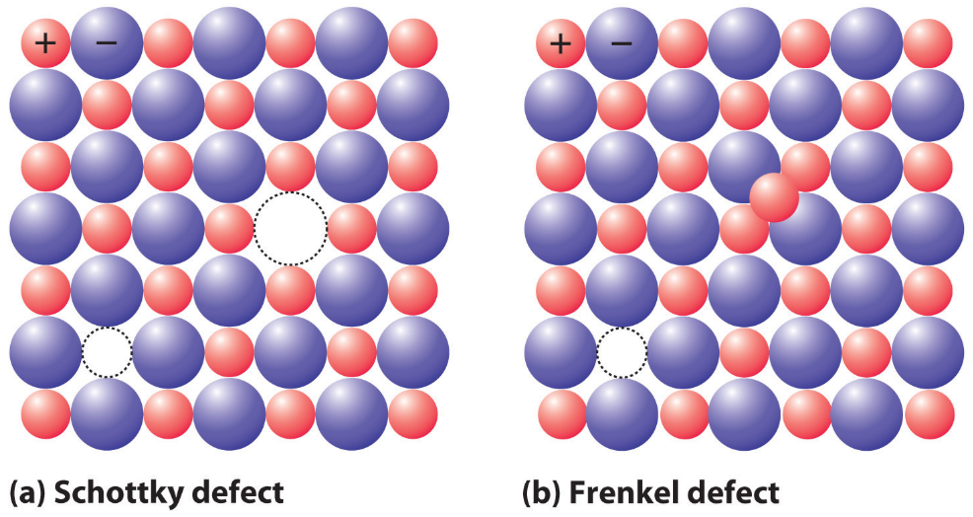
Reference: https://www.majordifferences.com/2013/02/difference-between-schottky-defect-and.html#.Xxhc8FUzbIU

Slide 50
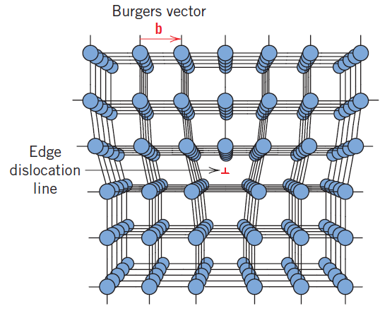
EDGE DISLOCATION
It is a linear defect that centers on the line that is defined along the end of the extra half-plane of atoms. This is sometimes termed the dislocation line, which, for the edge dislocation in Figure 4.3 is perpendicular to the plane of the page.
Within the region around the dislocation line there is some localized lattice distortion. The atoms above the dislocation line are squeezed together, and those below are pulled apart.
This is reflected in the slight curvature for the vertical planes of atoms as they bend around this extra half-plane. The magnitude of this distortion decreases with distance away from the dislocation line; at positions far removed, the crystal lattice is virtually perfect.
Symbol of edge dislocation line is shown in figure 4.3.
FIGURE 4.3

Slide 51
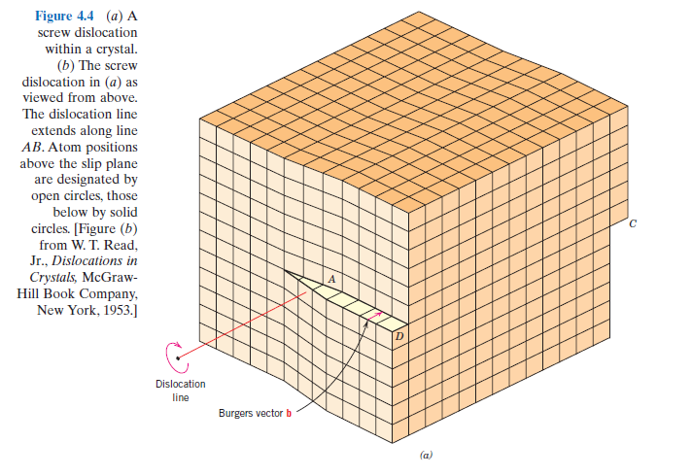

SCREW DISLOCATION

Slide 52

Another type of dislocation, called a screw dislocation, may be thought of as being formed by a shear stress that is applied to produce the distortion shown in Figure 4.4a: the upper front region of the crystal is shifted one atomic distance to the right relative to the bottom portion. The atomic distortion associated with a screw dislocation is also linear and along a dislocation line, line AB in Figure 4.4b.
The screw dislocation derives its name from the spiral or helical path or ramp that is traced around the dislocation line by the atomic planes of atoms. Sometimes the symbol is used to designate a screw dislocation.

Slide 53


MIXED DISLOCATION

Slide 54
MIXED DISLOCATION
Most dislocations found in crystalline materials are probably neither pure edge nor pure screw, but exhibit components of both types; these are termed mixed dislocations.
All three dislocation types are represented schematically in Figure 4.5; the lattice distortion that is produced away from the two faces is mixed, having varying degrees of screw and edge character.
The magnitude and direction of the lattice distortion associated with a dislocation is expressed in terms of a Burgers vector, denoted by a b. Burgers vectors are indicated in Figures 4.3 and 4.4 for edge and screw dislocations, respectively.

Slide 55
INTERFACIAL DEFECTS
Interfacial defects are boundaries that have two dimensions and normally separate regions of the materials that have different crystal structures and/or crystallographic orientations. These imperfections include external surfaces, grain boundaries, phase boundaries, twin boundaries, and stacking faults.

Slide 56

External Surfaces
One of the most obvious boundaries is the external surface, along which the crystal structure terminates.
Surface atoms are not bonded to the maximum number of nearest neighbors, and are therefore in a higher energy state than the atoms at interior positions.
To reduce this energy, materials tend to minimize, if at all possible, the total surface area. For example, liquids assume a shape having a minimum area—the droplets become spherical.

Slide 57
Grain Boundaries
Another interfacial defect, the grain boundary is the boundary separating two small grains or crystals having different crystallographic orientations in polycrystalline materials.
When this orientation mismatch is slight, on the order of a few degrees, then the term small- (or low-) angle grain boundary is used. (figure 4.7 in next slide)
One simple small-angle grain boundary is formed when edge dislocations are aligned in the manner of Figure 4.8(in next slide). This type is called a tilt boundary; the angle of misorientation, is also indicated in the figure.
There is an interfacial or grain boundary energy like the surface energy.
The magnitude of this energy is a function of the degree of misorientation, being larger for high-angle boundaries.
Grain boundaries are more chemically reactive than the grains themselves as a consequence of this boundary energy.
Impurity atoms often preferentially segregate along these boundaries because of their higher energy state

Slide 58


Figure 4.7
Figure 4.8

Slide 59

Twin Boundaries
A twin boundary is a special type of grain boundary across which there is a specific mirror lattice symmetry; that is, atoms on one side of the boundary are located in mirror-image positions of the atoms on the other side.
Twins result from atomic displacements that are produced from applied mechanical shear forces (mechanical twins), and also during annealing heat treatments following deformation (annealing twins).
Annealing twins are typically found in metals that have the FCC crystal structure, whereas mechanical twins are observed in BCC and HCP metals.

Slide 60

Thank you

